Slide 1
CJLR PDM&SRM 单点登录指南
场景一：在CJLR公司网络中（CJLR办公室／由VPN拨入），使用CJLR公司电脑登录：
使用IE浏览器打开SRM系统（http://srm.cheryjaguarlandrover.com/enovia），自动以电脑用户身份登录进入SRM，不用输入用户名和密码；
使用Firefox浏览器打开SRM系统（http://srm.cheryjaguarlandrover.com/enovia），会跳转IAM统一登录页（如图），按页面提示输入windows账户用户名和密码登录；若您已经使用同一浏览器登录了IAM界面，则以之前的登录身份直接进入SRM系统。
场景二：在CJLR公司网络中（CJLR办公室／由VPN拨入），使用非CJLR公司电脑登录：
使用IE/Firefox浏览器，输入SRM网址（http://srm.cheryjaguarlandrover.com/enovia），弹出IAM统一登录页（如图），按页面提示输入windows账户用户名和密码登录；若您已经使用同一浏览器登录了IAM界面，则以之前的登录身份直接进入SRM系统。
场景三：CJLR供应商在外网，访问SRM系统
使用IE9/Firefox浏览器打开（https://cjlr.portal.covisint.com）并输入用户名和密码登入Supplier Portal，然后点击打开CJLR SRM，即可直接进入SRM系统，而无需再次输入用户名密码。
NOTICE：集成IAM的系统只要用IE登陆后注销其中一个系统，其它系统也会注销。使用CJLR电脑非此电脑账号登陆需单独输入账号密码。

Slide 2
CJLR PDM&SRM Single-Sign-On Guide
1. In the company's internal network environment (In CJLR office / By the VPN dialing in), use the company computer to login SRM system (http://srm.cheryjaguarlandrover.com/enovia)： If you use IE browser，there is no need to press account and password and you will directly into the SRM system as the computer user identity. If you use Firefox browser, you will see the IAM unified login page (as shown) instead of the SRM page. According to the page prompts to enter your account and password, you can login to the SRM system. You will directly login SRM without pressing account and password, if you have logged IAM page in the same browser already. 2. In the company's internal network environment (In CJLR office / By the VPN dial in), use non company computer to login SRM system (http://srm.cheryjaguarlandrover.com/enovia)： You will see the IAM unified login page (as shown), according to the page prompts to enter your account and password, you can log in SRM system. You will directly login SRM without pressing account and password, if you have logged IAM page in the same browser. 3. CJLR suppliers in the internet, access to SRM system You can use IE9/Firefox to open the browser (https://cjlr.portal.covisint.com) ,enter a user name and password to login Supplier Portal, click CJLR SRM, and then can be directly into the SRM system, without to enter a username and password again.

Slide 3
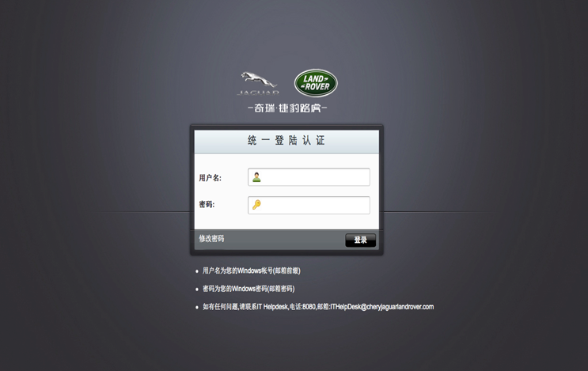
CJLR 员工单点登录界面 CJLR Staff Only SSO Login
Note：
单点系统登录用户名和密码同登录Windows的用户名和密码，原PDM&SRM系统的密码将不再使用。
The login username and password the same as your Windows login username and password. Previews SRM password no longer in use.

Slide 4
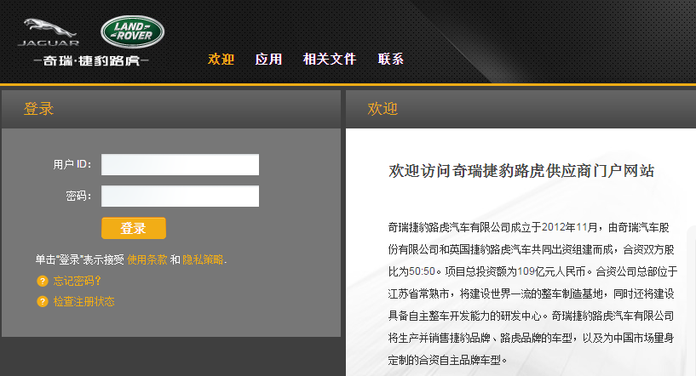
供应商登录界面 CJLR SRM Supplier Login Page
使用浏览器打开（https://cjlr.portal.covisint.com）并输入用户名和密码登入Supplier Portal
Open the browser (https://cjlr.portal.covisint.com) ,enter a user name and password to login Supplier Portal

Slide 5
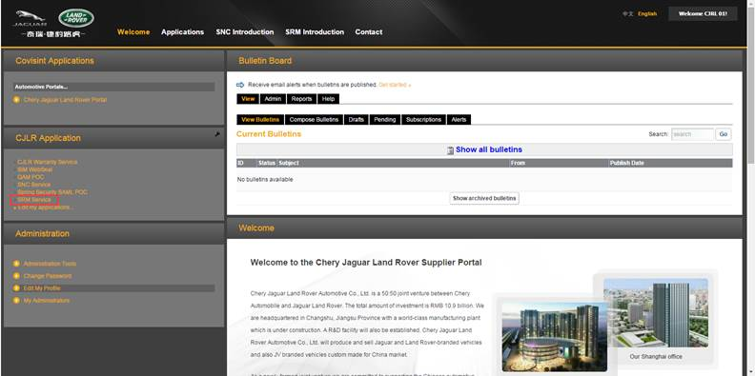
供应商登录界面 CJLR SRM Supplier Login Page
登录成功后，在点击左边CJLR Application 下面的‘SRM Service’链接，可直接打开SRM系统，无需再次登录。
After login, please find the ‘SRM Service’ in the left frame. Click to visit SRM and not need to login again.

Slide 6
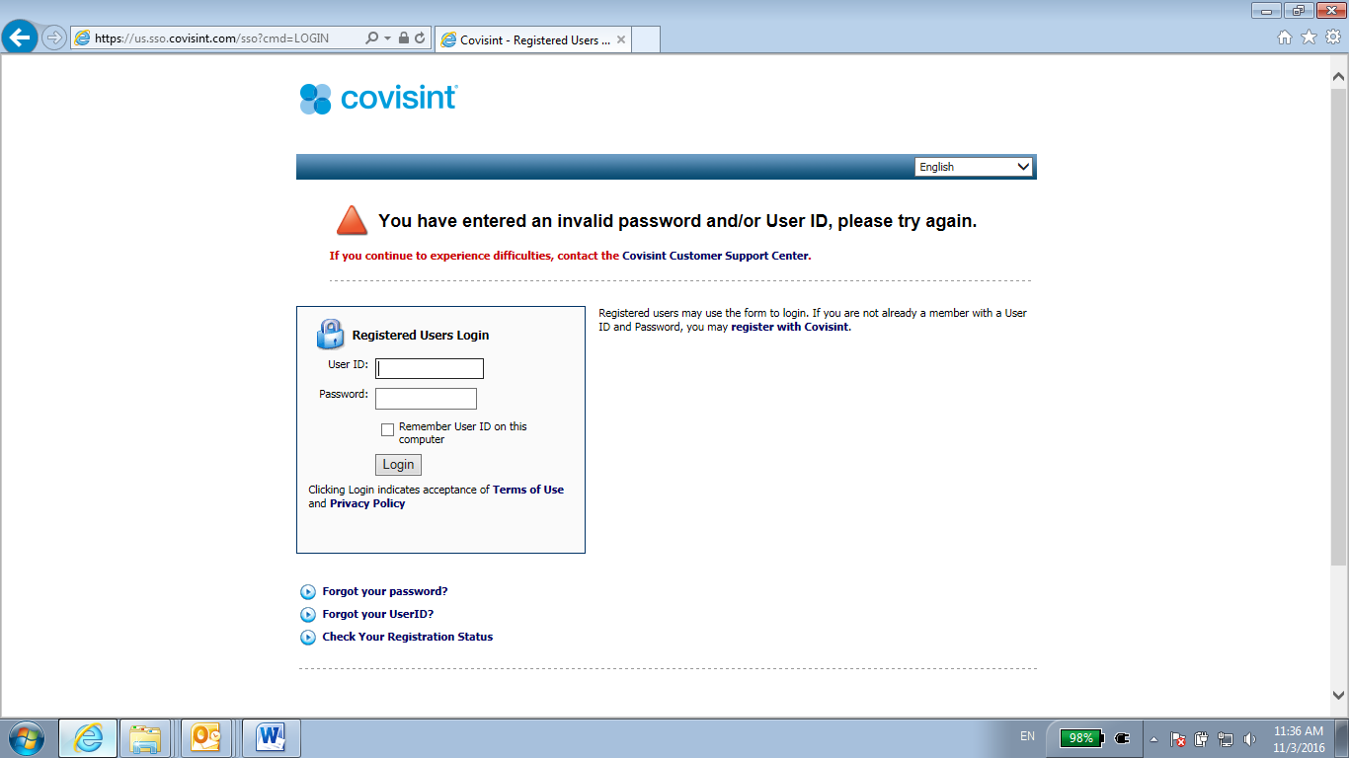
供应商登录常见问题 Supplier Login Issues
如果遇到用户名或者密码错误，请邮件反馈到相关Buyer或STA，IThelpdesk协助解决。
可重置第一层密码解决
If your username and password not correct, please contact related Buyer, STA and IThelpdesk, ask help. It can be fixed by reset password.

Slide 7
供应商登录常见问题 Supplier Login Issues
如果登录进去是空白页面，
1.可能选用了错误的浏览器，建议更换IE 9 浏览器重新登录；
2. 可能是使用了以前保存的SRM Service的链接直接登录的，没有登录Covisint系统。建议参考本指南的登录方式先登录到Covisint系统再通过链接访问SRM Service
If you got blank page after login,
1. Maybe it’s incompatible browser, please re-login with IE 9;
2. Maybe it’s wrong URL, please follow this guide to login Covisint system first, and visit SRM via official link.

Slide 8
供应商登录常见问题 Supplier Login Issues
如果登录进去是ORACLE背景的系统错误页面，
1.可能Covisint（第一层）系统用户名和SRM（第二层）系统用户名不一致导致的
2.可能单点系统数据库中未加入此供应商
3.可能是浏览器不是SRM系统兼容浏览器，请更换IE9浏览器重新登录
1、2点请联系相关Buyer，STA 和IThelpdesk，反馈问题。
If you got system error,
1. Maybe the username not match between Covisint and SRM
2. Maybe the SSO system didn’t include this supplier account
Above 2, please contact related Buyer, STA and IThelpdesk, ask help.
3.Maybe it’s incompatible browser, please re-login with IE 9.

Slide 9
IT Helpdesk
如果您对应用系统有任何疑问，请联系IT Helpdesk
电话: +86 021 2223 8080
邮箱: ITHelpdesk@cheryjaguarlandrover.com
If you have any question about SRM application, please contact IT Helpdesk.
Phone: +86 021 2223 8080
Email: ITHelpdesk@cheryjaguarlandrover.com

